Slide 1

TYPES OF COMMUNICATION NETWORKS

Slide 2
COMMUNICATION NETWORKS
It refers to the patterns that emerge when communication through vertical, horizontal and diagonal channels are combined.
They are divided into formal network models and informal network models.

Slide 3
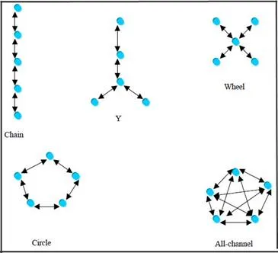
THE FORMAL NETWORK MODELS
Figure 4: The different types of formal network models

Slide 4
THE Y NETWORK AND THE WHEEL NETWORK
Y network- refers to a multi-level hierarchy and a combination of vertical and horizontal flow of communication.
The Y turned upside down refers to two subordinates reporting to one senior.
The wheel network refers to subordinates reporting to a superior.
Wheel network is a combination of horizontal and diagonal flow of communication.
In wheel network , the subordinates do not interact with each other.

Slide 5
CIRCLE NETWORK AND ALL CHANNEL NETWORK
The circle network allows employees to interact with adjacent members only.
It has three levels of hierarchy.
In all channel networks, all employees freely communicate with all others.
Everyone’s views are equally and openly shared.

Slide 6
WHICH NETWORK IS MOST SUITABLE?
No single network is suitable for all occasions.
The wheel and all-channel networks are preferred if the speed of communication is important.
The chain, Y and wheel networks are useful when accuracy is important.

Slide 7
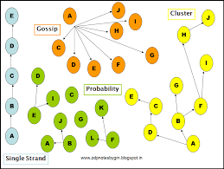
INFORMAL NETWORK MODELS
The informal network-or the grapevine is active in almost every organization.

